Slide 1
BIOL 350: Bioinformatics
Introduction to genetic association studies

Slide 2
What is a SNP?
Polymorphisms and their role in genetics

Slide 3
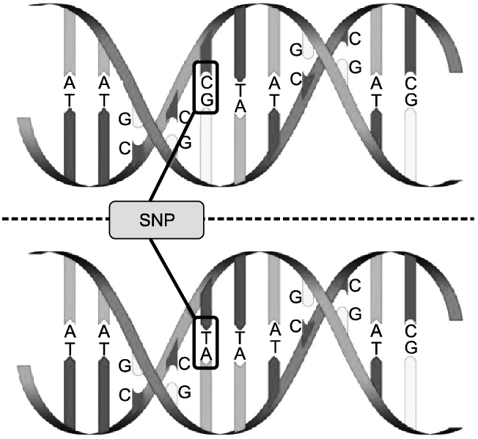
Single-nucleotide polymorphisms
Polymorphism is the tendency of DNA to admit of different nucleotide pairs at a single locus

Slide 4
Single-nucleotide polymorphisms
Of 3.2 billion bases, any individual is polymorphic at 4–5 million sites

Slide 5
Single-nucleotide polymorphisms
The more common allele is called the major allele
The less common allele is called the minor allele

Slide 6
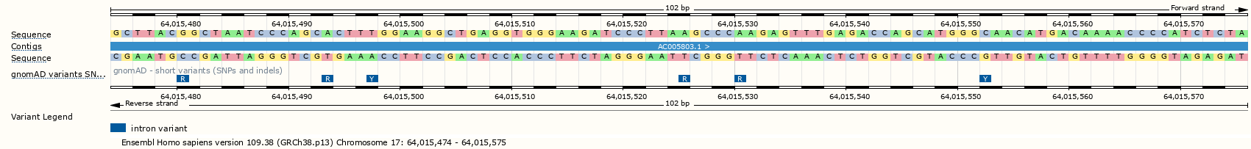
IUPAC-IUB SNP codes
More than just A, T, G, and C?

Slide 7
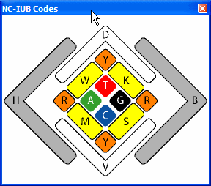
IUPAC-IUB SNP codes
Each polymorphism is coded by its possible alleles
https://www.gendx.com/SBTengine/Help_220/hs310.htm

Slide 8
IUPAC-IUB SNP codes
Code | Meaning | Explanation
R | A or G | PuRrine
Y | C or T | PYrimidine
S | G or C | Strong H-bonding
W | A or T | Weak H-bonging
K | G or T | Keto bases
M | A or C | aMino bases
B | C or G or T | not A
D | A or G or T | not C
H | A or C or T | not G
V | A or C or G | not T
N | A or C or G or T | ANy
Each polymorphism is coded by its possible alleles

Slide 9
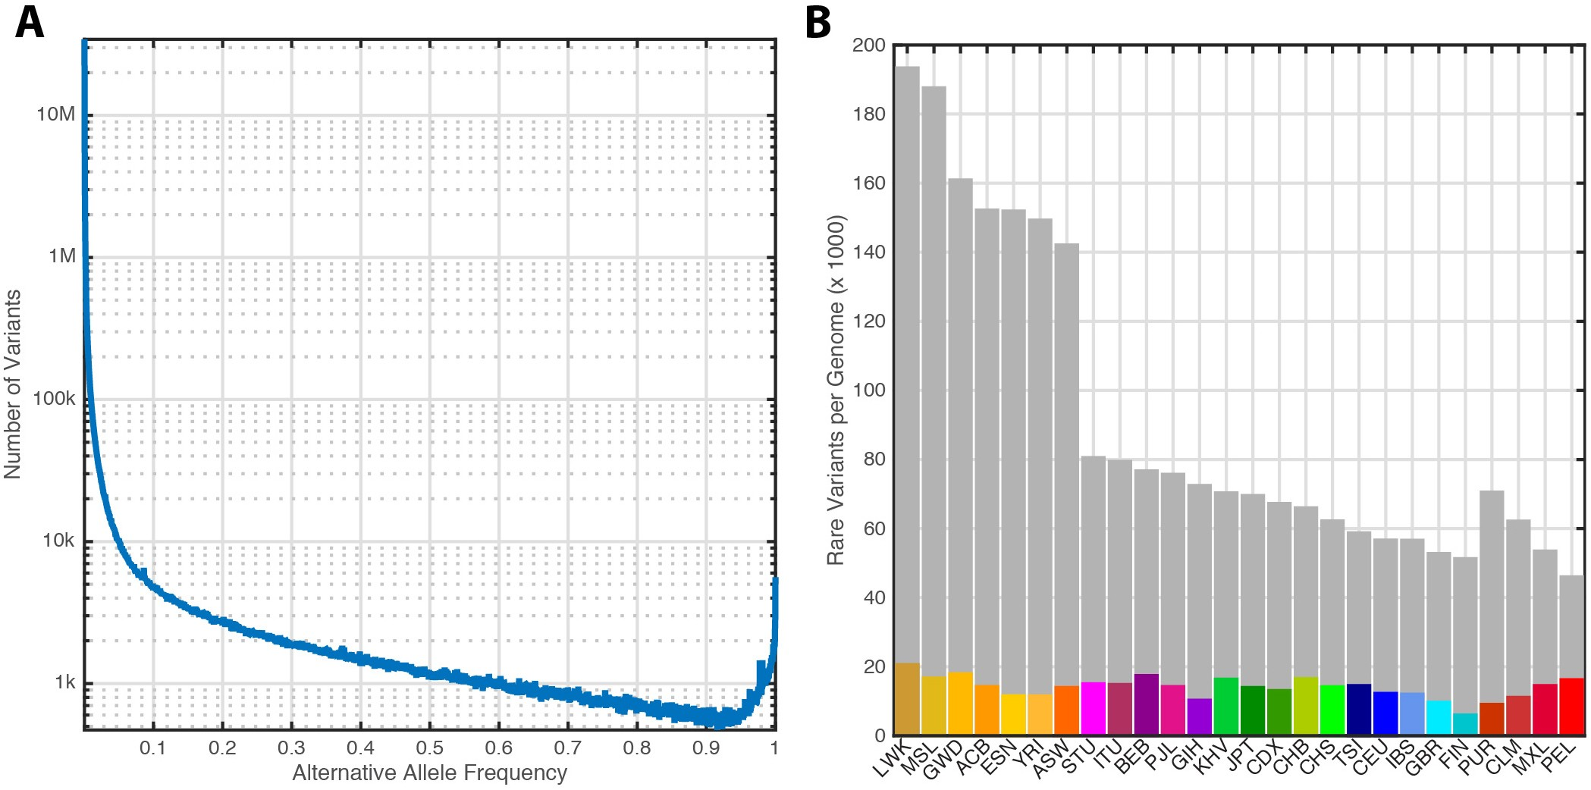
Many rare SNPs
Common SNPs have minor allele frequency (MAF) >5%
https://www.nature.com/articles/nature15393

Slide 10
Many rare SNPs
Most SNPs of the >600 million known SNPs are very rare (frequency < 0.5%)
https://www.nature.com/articles/nature15393

Slide 11
Many rare SNPs
But only <5% of an individual’s genome consists of rare SNPs
https://www.nature.com/articles/nature15393

Slide 12
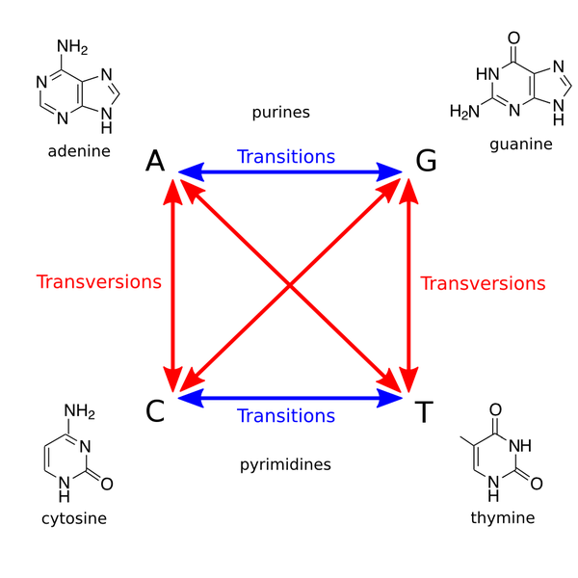
Transitions and transversions
Transitions occur between nucleotides of the same type (purines or pyrimidines)

Slide 13
Transitions and transversions
Transversions occur between nucleotides of opposite type (between purines and pyrimidine)

Slide 14
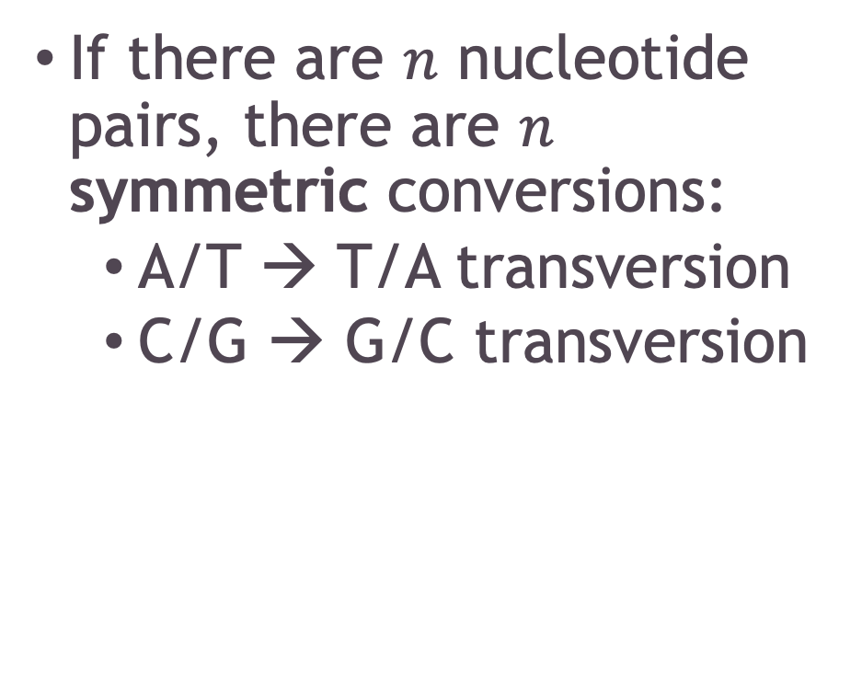
How many polymorphisms are there?
If there are $n$ nucleotide pairs, there are $n$ symmetric conversions:
A/T → T/A transversion
C/G → G/C transversion

Slide 15
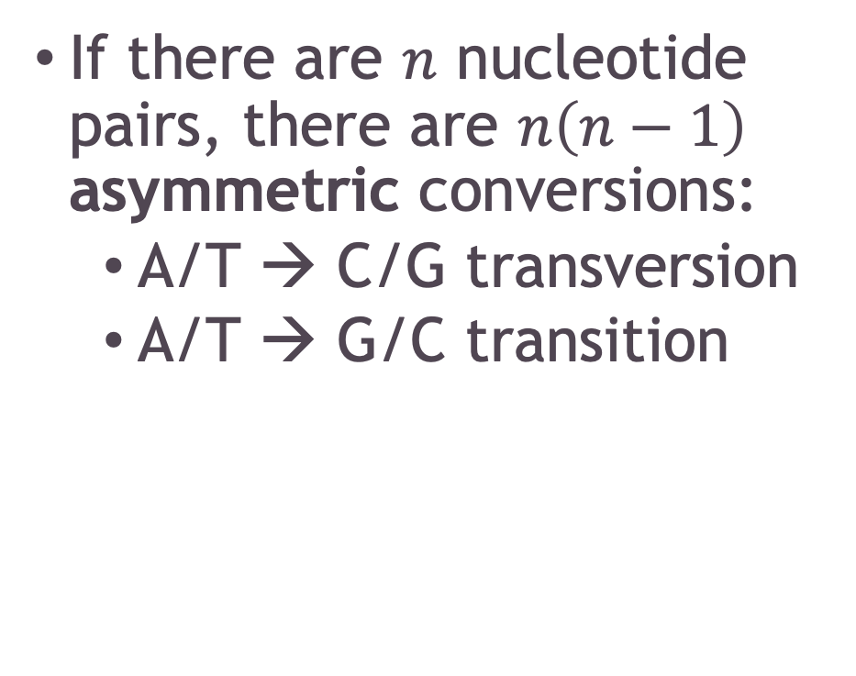
How many polymorphisms are there?
If there are $n$ nucleotide pairs, there are $n\left(n−1\right)$ asymmetric conversions:
A/T → C/G transversion
A/T → G/C transition

Slide 16
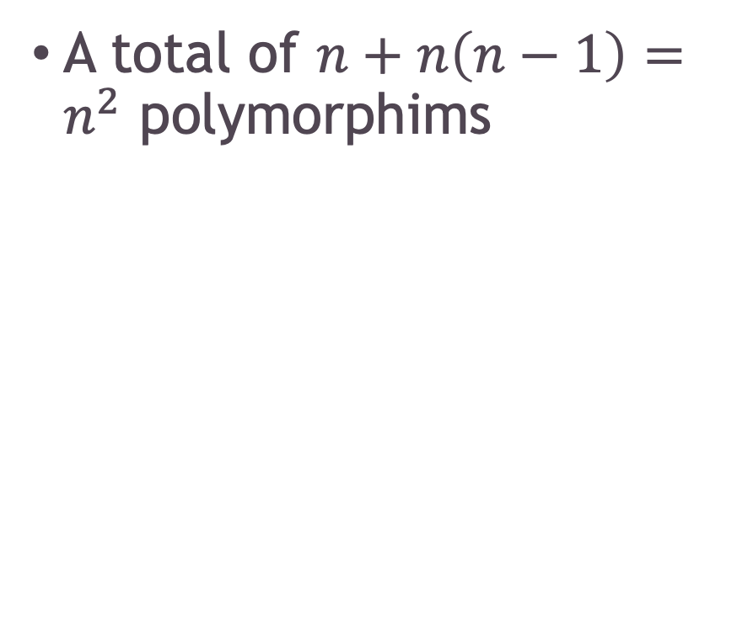
How many polymorphisms are there?
A total of $n+n\left(n−1\right)=n^{2}$ polymorphims

Slide 17
Transition-transversion ratio
Even though there are three times as many transversions possible as transitions, in humans the ratio of transitions to transversions is approximately 2, genome-wide
https://pubmed.ncbi.nlm.nih.gov/25297068/

Slide 18
Transition-transversion ratio
In coding regions, the Ti:Tv ratio is as high as 3
https://pubmed.ncbi.nlm.nih.gov/25297068/

Slide 19
Generation of sequencing data
Sequencing technologies and data formats

Slide 20
How do we get human genotypes?
SNP Chips
Whole-genome sequencing

Slide 21
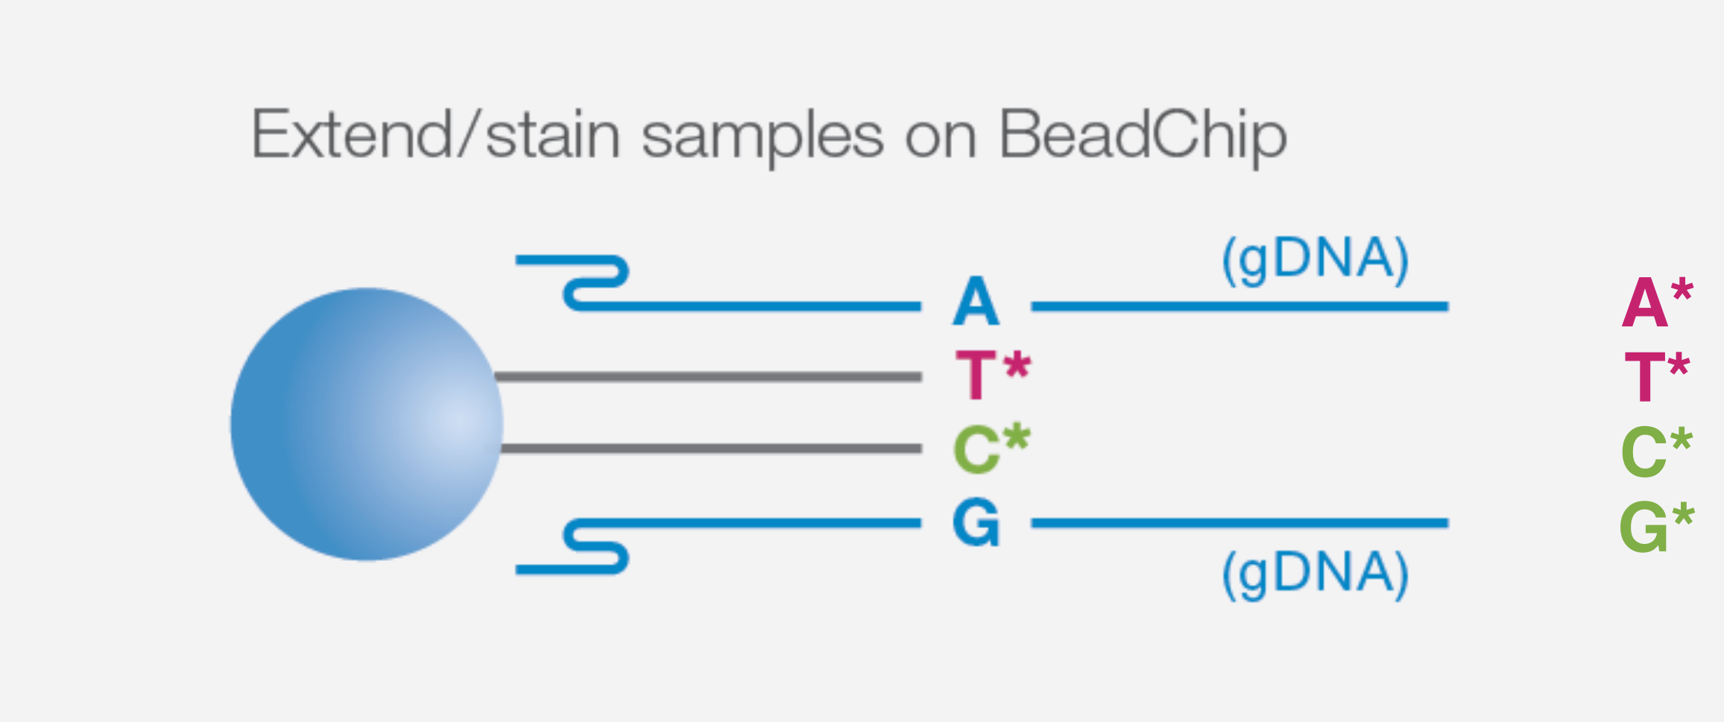

SNP Chips
Genomic DNA binds to a complementary sequence and incorporates a fluorescently labelled nucleotide

Slide 22
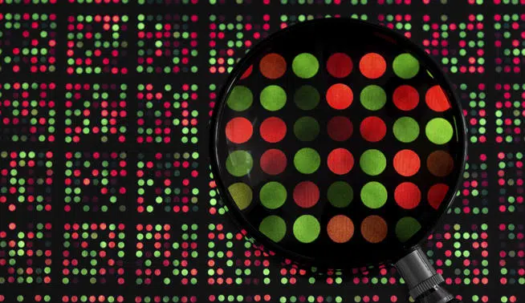
SNP Chips
The ratio of red to green at a spot identifies the sample allele

Slide 23
Whole-genome sequencing (WGS)
DNA fragments from a sample are attached to a flow cell and amplified
Clark et al. Molecular Biology (3rd Edition). Ch. 8: DNA Sequencing, 240-269 (2019)

Slide 24
Whole-genome sequencing (WGS)
Sequencing by synthesis: Short reads are produced as fluorescent nucleotides are incorporated one base at a time
Clark et al. Molecular Biology (3rd Edition). Ch. 8: DNA Sequencing, 240-269 (2019)

Slide 25
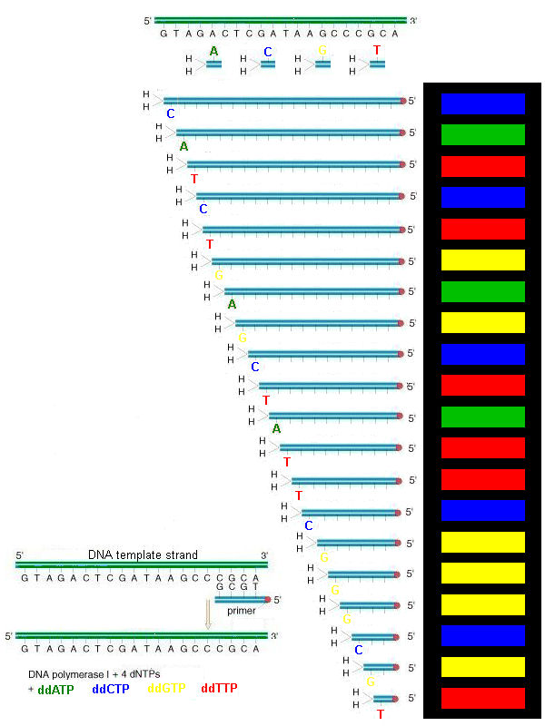
Whole-genome sequencing (WGS)
The DNA sequence is inferred from the sequence of fluorescence images

Slide 26
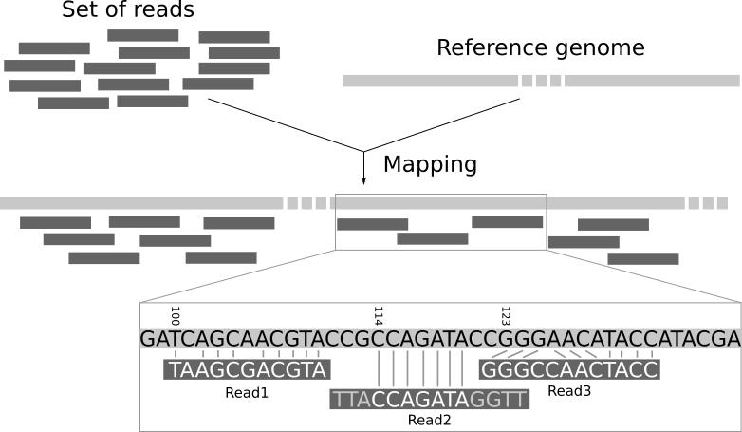
Mapping to the reference genome
Locate where in the genome the reads came from, and detect single-nucleotide differences from the reference sequence

Slide 27
Data-processing pipeline
Generate raw reads
Align to a reference genome
Detect variant sites

Slide 28
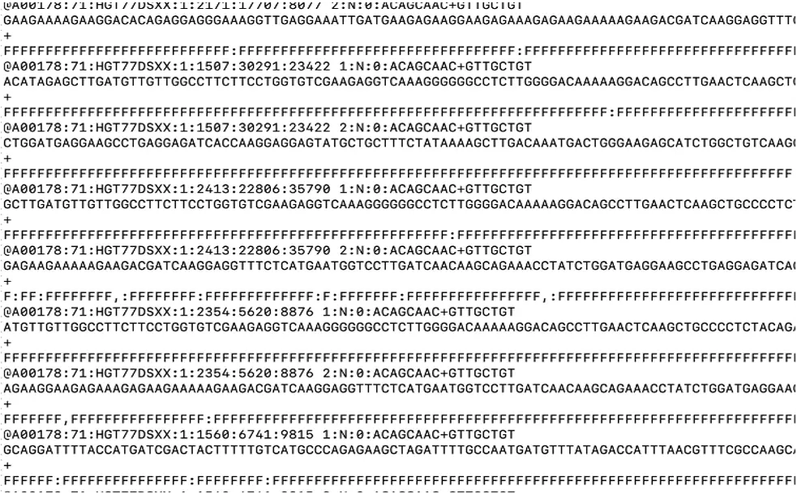
FASTQ
Contains raw sequence reads and their quality scores to be aligned to a reference genome (FASTA)

Slide 29
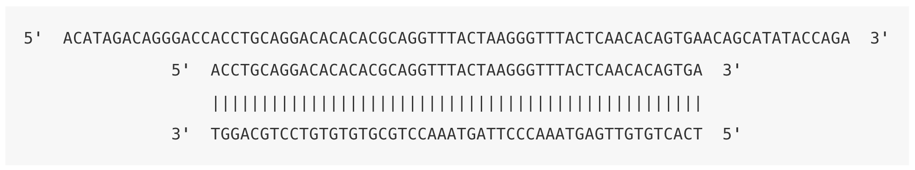
SAM (BAM)
Paired-end reads are aligned to either the forward or reverse strand of the reference genome
https://eriqande.github.io/eca-bioinf-handbook/bioinformatic-file-formats.html#sambamfiles

Slide 30
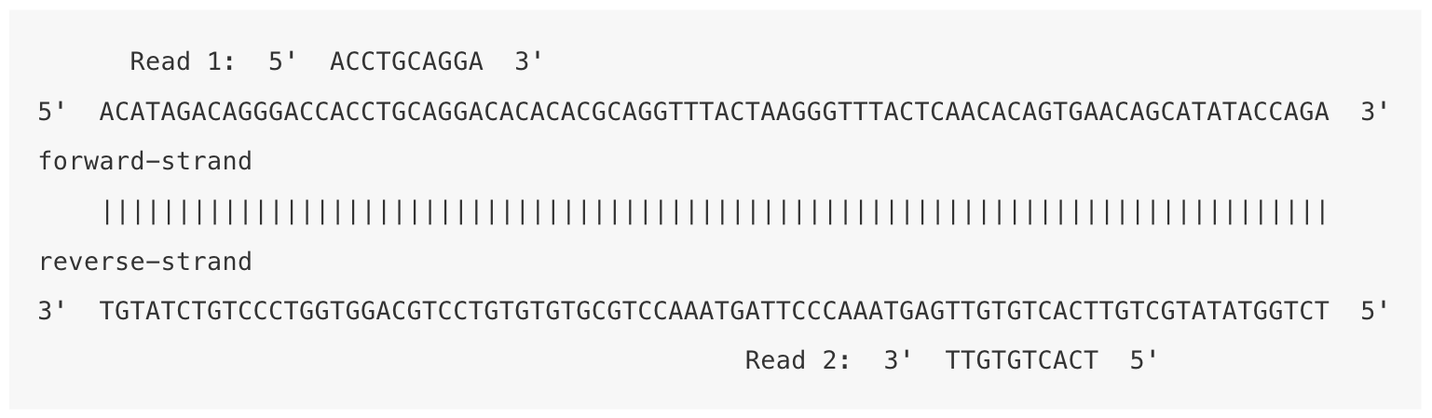
SAM (BAM)
Paired-end reads are aligned to either the forward or reverse strand of the reference genome
https://eriqande.github.io/eca-bioinf-handbook/bioinformatic-file-formats.html#sambamfiles

Slide 31
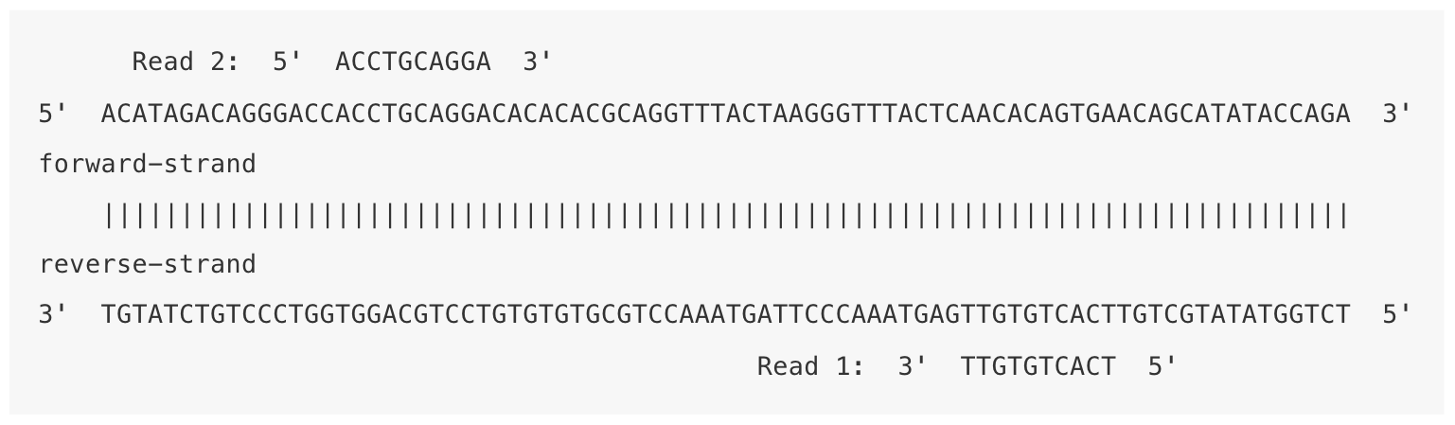
SAM (BAM)
Paired-end reads are aligned to either the forward or reverse strand of the reference genome
https://eriqande.github.io/eca-bioinf-handbook/bioinformatic-file-formats.html#sambamfiles

Slide 32
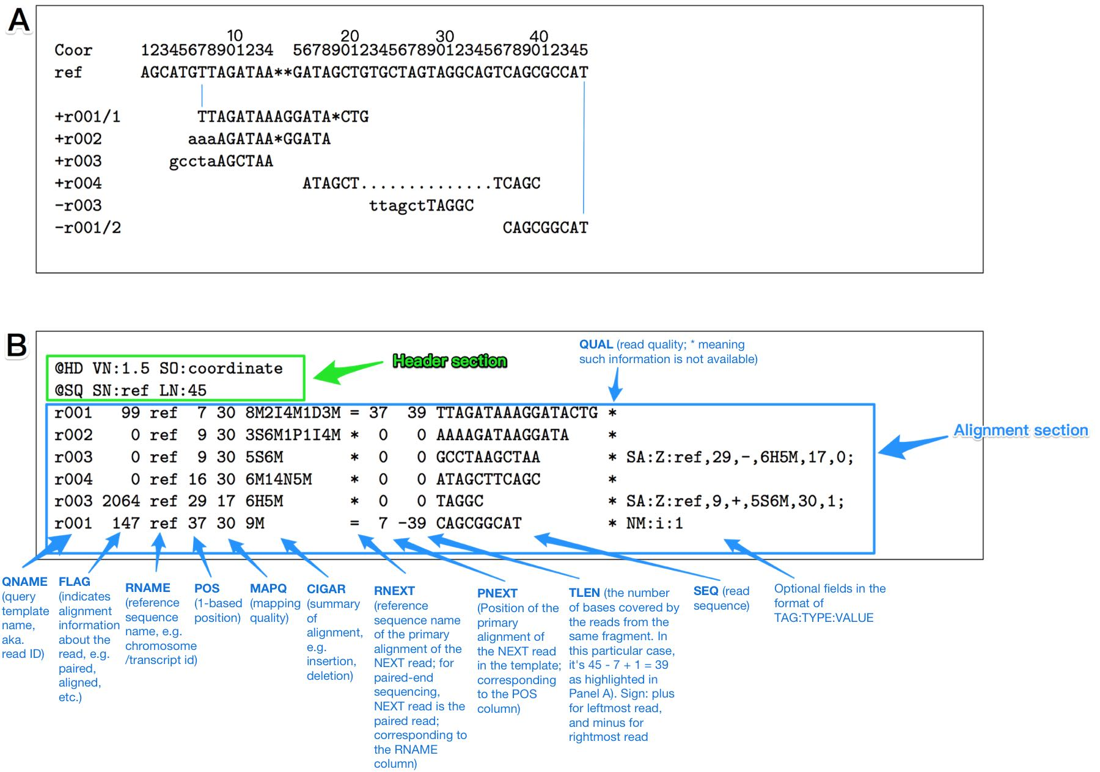
SAM (BAM)
A Sequence alignment map (SAM) or binary alignment map (BAM) file contains the alignments to the reference genome

Slide 33
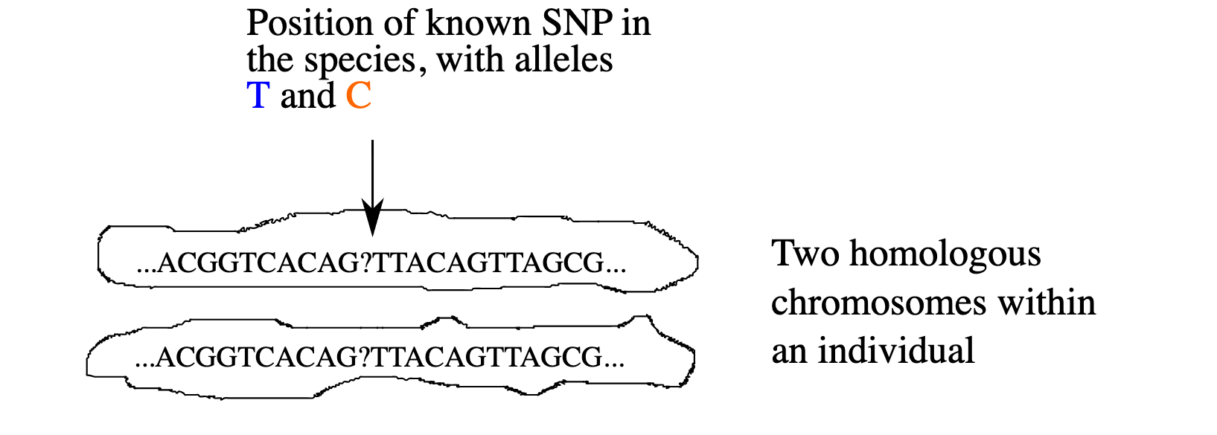
Variant calling (mpileup)
How certain can we be of an individual’s genotype?
https://eriqande.github.io/eca-bioinf-handbook/bioinformatic-file-formats.html#sambamfiles

Slide 34
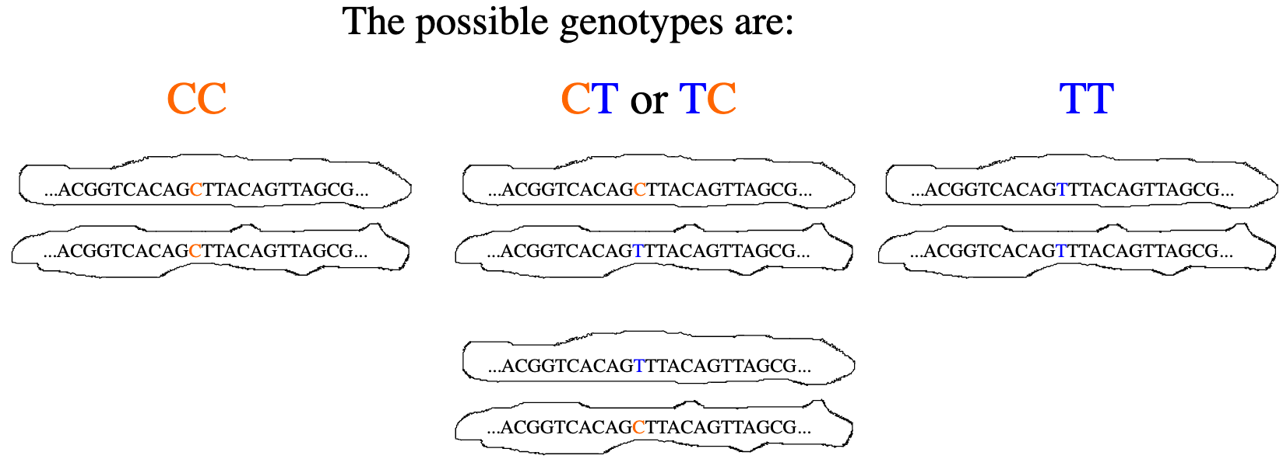
Variant calling (mpileup)
How certain can we be of an individual’s genotype?
https://eriqande.github.io/eca-bioinf-handbook/bioinformatic-file-formats.html#sambamfiles

Slide 35
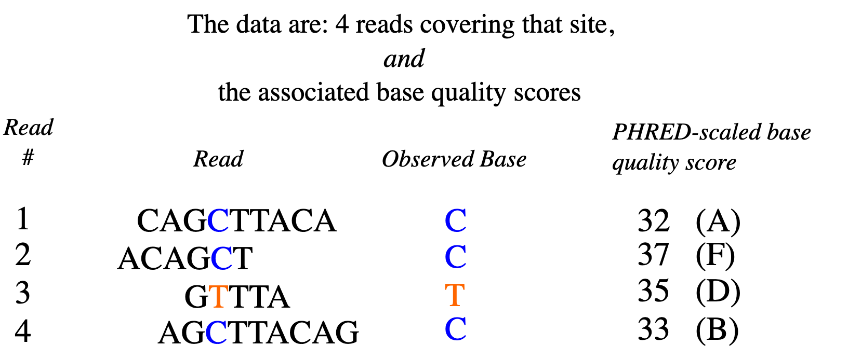
Variant calling (mpileup)
How certain can we be of an individual’s genotype?
https://eriqande.github.io/eca-bioinf-handbook/bioinformatic-file-formats.html#sambamfiles

Slide 36
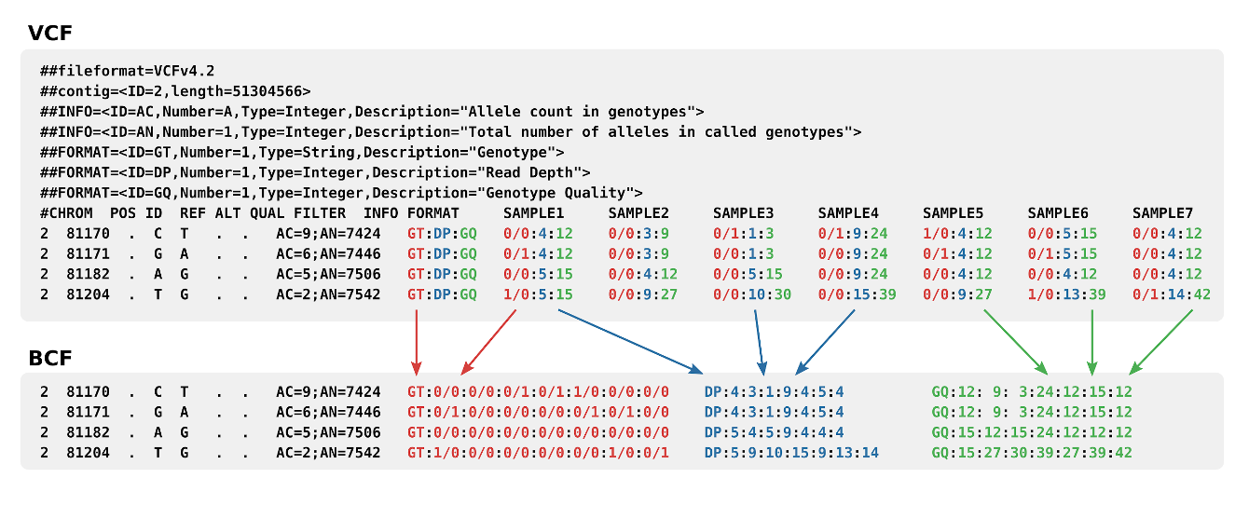
VCF
The results of genotype-calling are stored in a variant call format (VCF) file

Slide 37
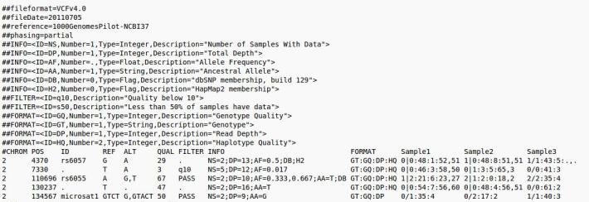
VCF
The VCF file has one row for each variant, and one column for each sequenced individual

Slide 38
VCF
Codes such as GT, DP, GP give the genotype, read depth, and genotype probabilities for each individual

Slide 39
Human genetic variation
Sequencing projects and implications for association studies

Slide 40
The HapMap Project
International genotyping consortium launched in 2002 to find common polymorphisms linked to rare disease loci
https://pubmed.ncbi.nlm.nih.gov/16255080/

Slide 41
The HapMap Project
Variants occur together on a small number of haplotypes
https://pubmed.ncbi.nlm.nih.gov/16255080/

Slide 42
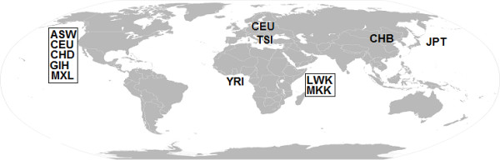
The HapMap Project
Phase 3 (2010): genotyping and PCR resequencing of 1.6 million SNPs from 1,184 human samples from different parts of the world

Slide 43
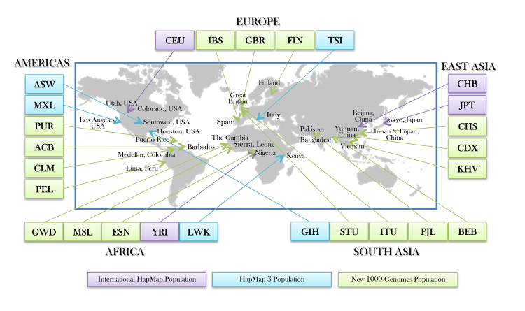
The 1000 Genomes Project
An international consortium launched in 2008 to catalog rare variants (frequency < 1%) taking advantage of new sequencing technologies

Slide 44
The 1000 Genomes Project
Phase 3 release (2015) contained data from 2,504 individuals representing 26 populations across the globe, and identified 85 million new SNPs

Slide 45
Global genetic variation
Most SNPs are shared across continents, and the majority of variation (~85%) is within rather than between populations

Slide 46

The same yet different?
Most variation is within-populations rather than between-populations
Yet regional differences in allele frequencies lead to noticeable differences in phenotypes

Slide 47
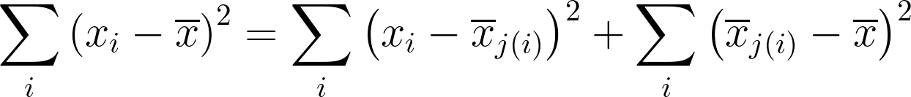
Statistical variation of an allele
Variation of the counts x_{i} of an allele about the group mean x̅_{j} and the population mean x̅
Total variation
Within-population variation
Between-population variation

Slide 48
Pitfalls of not accounting for genetic ancestry
Because of allele-frequency differences in global populations, spurious associations with disease risk can show up that may be entirely explained by genetic ancestry

Slide 49
Example: lactase nonpersistence (lactose intolerance)
The T allele of rs182549 is completely associated with the ability to digest lactose in Europeans
 | CC | CT | TT
Non-persistence | 59 | 0 | 0
Persistence | 0 | 63 | 74
https://pubmed.ncbi.nlm.nih.gov/11788828/

Slide 50
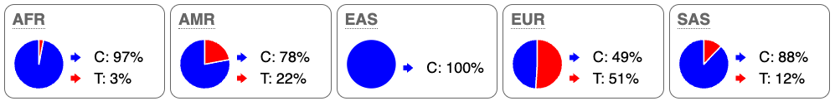
Example: lactase nonpersistence (lactose intolerance)
Yet the polymorphism is almost absent in the African population, despite the presence of lactase persistence https://pubmed.ncbi.nlm.nih.gov/15106124/

Slide 51
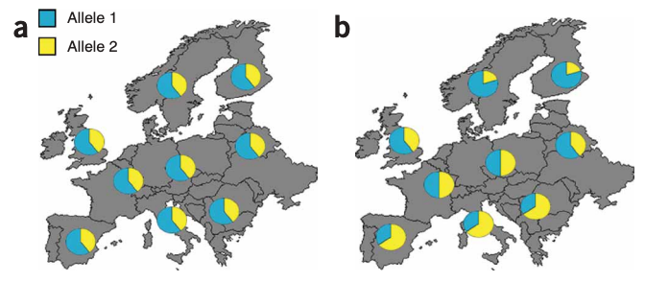
Population stratification
An allele may appear associated with a phenotype, when in fact it is associated with geographic origin (genetic ancestry)

Slide 52
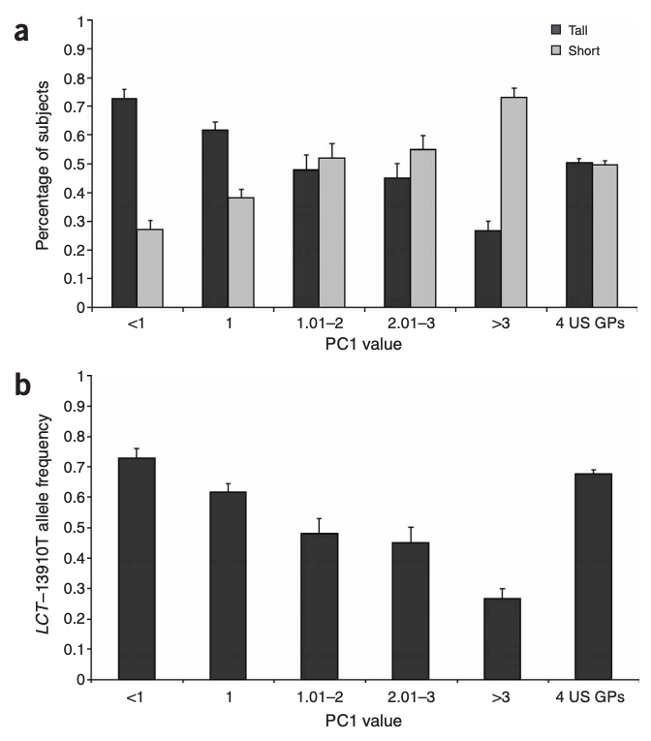
Spurious association
An allele of the lactase-persistence SNP is spuriously associated with height, as its frequency is higher in individuals with Northern European ancestry vs. Southern
Northwest
Southeast
https://pubmed.ncbi.nlm.nih.gov/16041375/

Slide 53
Principal components analysis
The concept of genetic ancestry

Slide 54
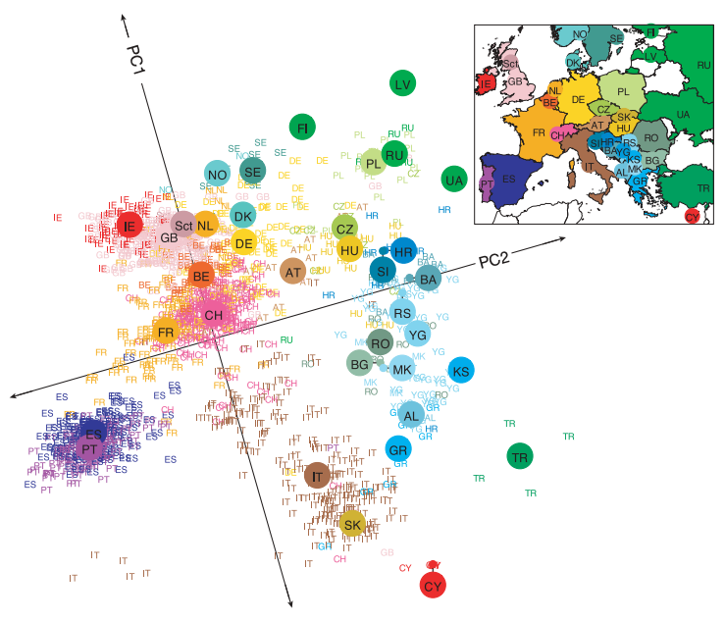
Principal components analysis
Genotypes can distinguish population groups
https://pubmed.ncbi.nlm.nih.gov/18758442/

Slide 55
Principal components analysis
Looking at which variants segregate together can tell us about an individual’s likely genetic ancestry
https://pubmed.ncbi.nlm.nih.gov/18758442/

Slide 56
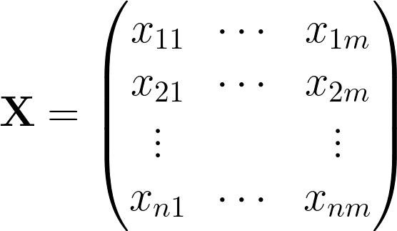
Genotype matrix
m SNPs
n individuals are genotyped at m SNPs
n subjects

Slide 57
Genotype matrix
m SNPs
The number of alternate alleles is 0, 1, or 2
n subjects

Slide 58
Genotype matrix
m SNPs
“Standardize” each genotype by subtracting the mean allele (column) frequency and dividing by its standard error
n subjects

Slide 59
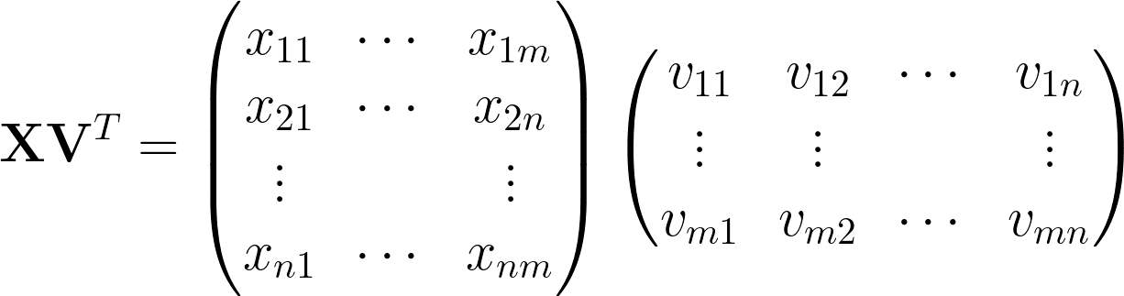
“Idealized” individuals
An “idealized” subject of a particular genetic ancestry has genotypes v at m SNPs

Slide 60
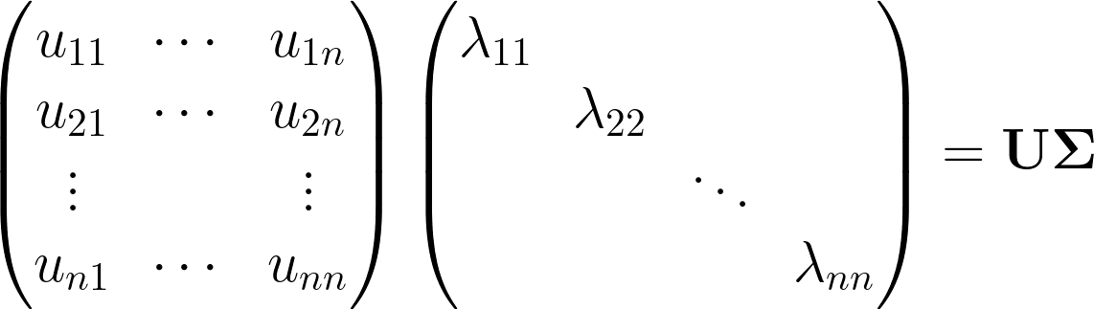
“Idealized” individuals
The position u₁₁λ₁₁ of individual 1 on PC1 is the “amount” of idealized person 1 in individual 1

Slide 61
“Idealized” individuals
The position u_{ij}λ_{jj} of individual i on PCj is the “amount” of idealized person j in individual i

Slide 62
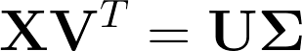
“Idealized” individuals
The idea of PCA is to find the amount of each idealized individual in each actual individual using the decomposition of the n × m genotype matrix X into n × n, n × n, and n × m matrices U, Σ, and V

Slide 63
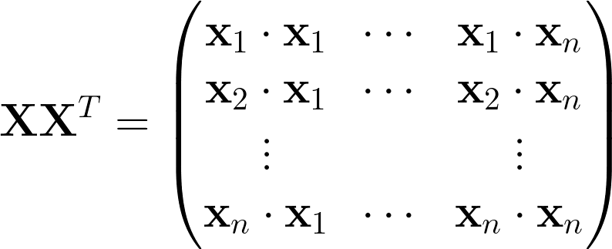
Genomic relationship matrix (GRM)
The GRM is computed by comparing how similar any subject is to any other

Slide 64
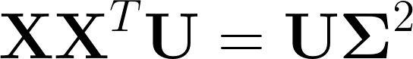
Genomic relationship matrix (GRM)
The eigenvectors (columns of U) of the GRM contain the ancestry components

Slide 65
Linkage disequilibrium
Determining a set of independent SNPs

Slide 66
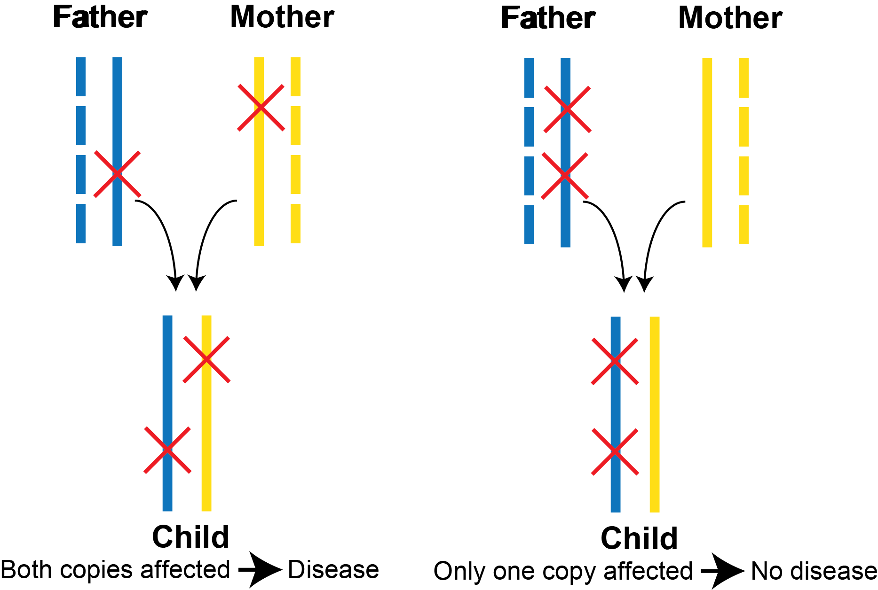
SNPs can occur on either of two chromosomes
Genotype data do not tell us which chromosomes carry the polymorphism

Slide 67
SNPs can occur on either of two chromosomes
When at least one parent is homozygous at each SNP, haplotype phase can be unambiguously assigned

Slide 68
SNPs can occur on either of two chromosomes
and we can distinguish AB/ab from Ab/aB

Slide 69
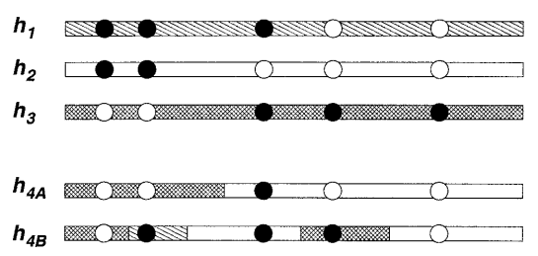
Statistical phasing and imputation
Genotyped individuals can be computationally phased by modelling each chromosome as an imperfect mosaic of chromosomes from a reference panel
https://pubmed.ncbi.nlm.nih.gov/14704198/

Slide 70
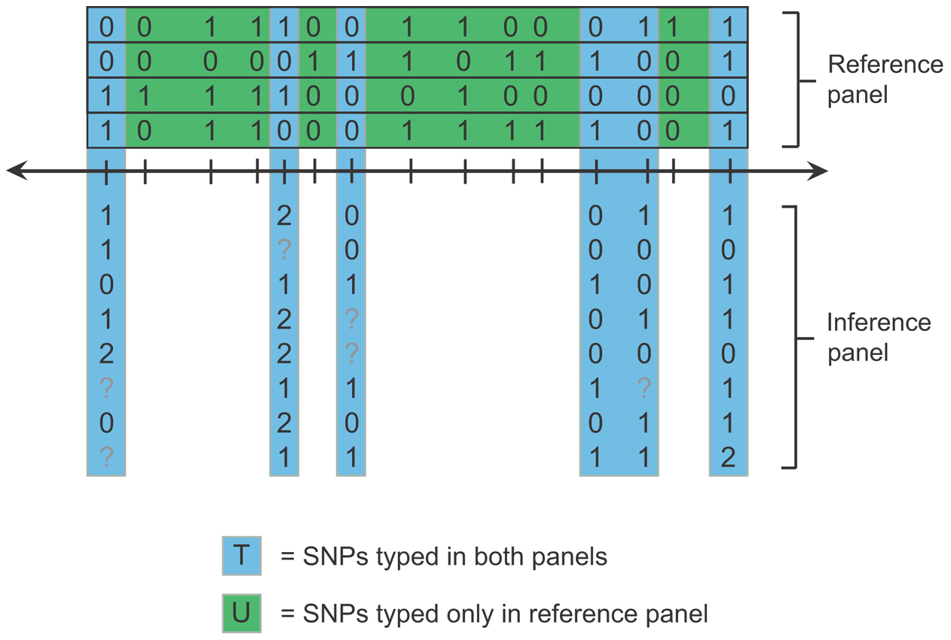
Statistical phasing and imputation
Variants that have not been typed can be imputed into the inference sample
https://pubmed.ncbi.nlm.nih.gov/19543373/

Slide 71
Statistical phasing and imputation
Imputation accuracy depends on the inference and reference samples being of similar genetic ancestry
https://pubmed.ncbi.nlm.nih.gov/19543373/

Slide 72
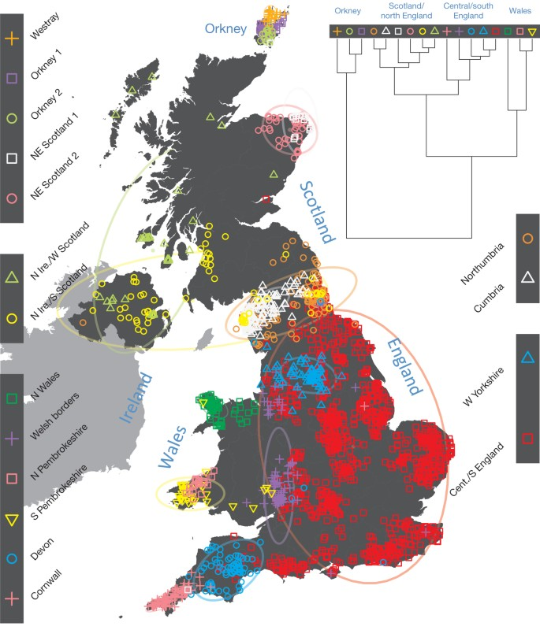
Different haplotypes distinguish different populations
Individuals can be grouped into populations with which they have the most haplotype-sharing
https://pubmed.ncbi.nlm.nih.gov/25788095/

Slide 73
Linkage disequilibrium
Linkage disequilibrium is the population tendency of alleles to be inherited on a single chromosome

Slide 74
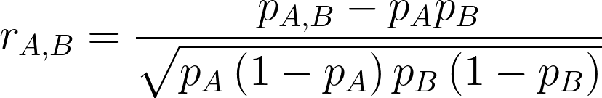
Linkage disequilibrium
LD is measured as the correlation coefficient between the alleles of different SNPs

Slide 75
Linkage disequilibrium
p_{A} = fraction of chromosomes with A
p_{AB} = fraction of chromosomes with A and B

Slide 76
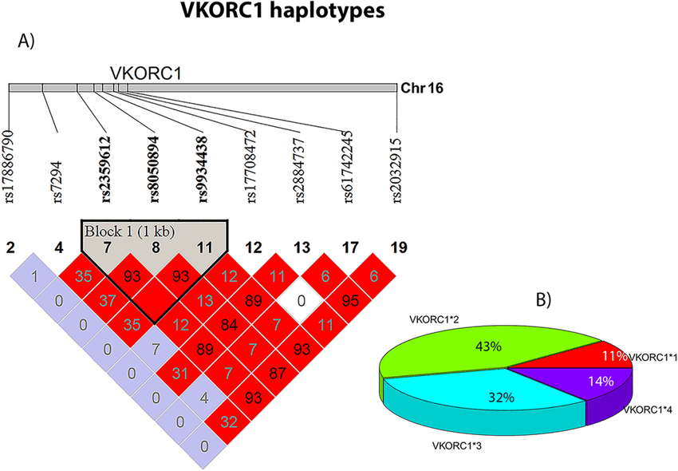
LD blocks and haplotype structure
Plots of pairwise r² values show which SNPs are inherited together in the population as common haplotypes
https://pubmed.ncbi.nlm.nih.gov/32221414/

Slide 77
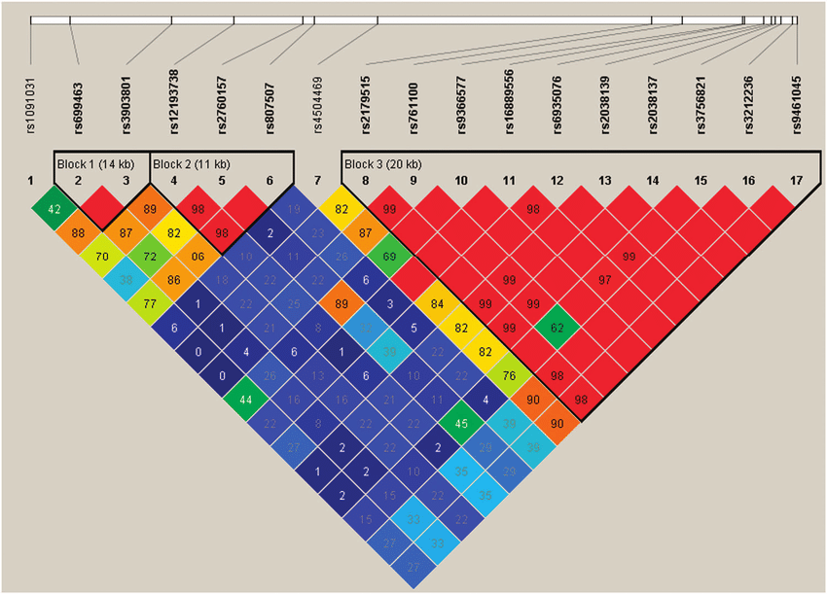
An algorithm for computing an independent subset of alleles
From the SNPRelate package https://rdrr.io/bioc/SNPRelate/man/snpgdsLDpruning.html

Slide 78
An algorithm for computing an independent subset of alleles
Pick a random SNP

Slide 79
An algorithm for computing an independent subset of alleles
Compute the LD with every other SNP within a sliding window of predetermined size
Window size

Slide 80
An algorithm for computing an independent subset of alleles
If LD > threshold, remove the SNP
Window size

Slide 81
An algorithm for computing an independent subset of alleles
Else it becomes a new independent SNP
Window size

Slide 82
An algorithm for computing an independent subset of alleles
The algorithm is random, and should be initiated from a fixed seed
Window size

Slide 83
Kinship analysis
The concept of genetic relatedness

Slide 84
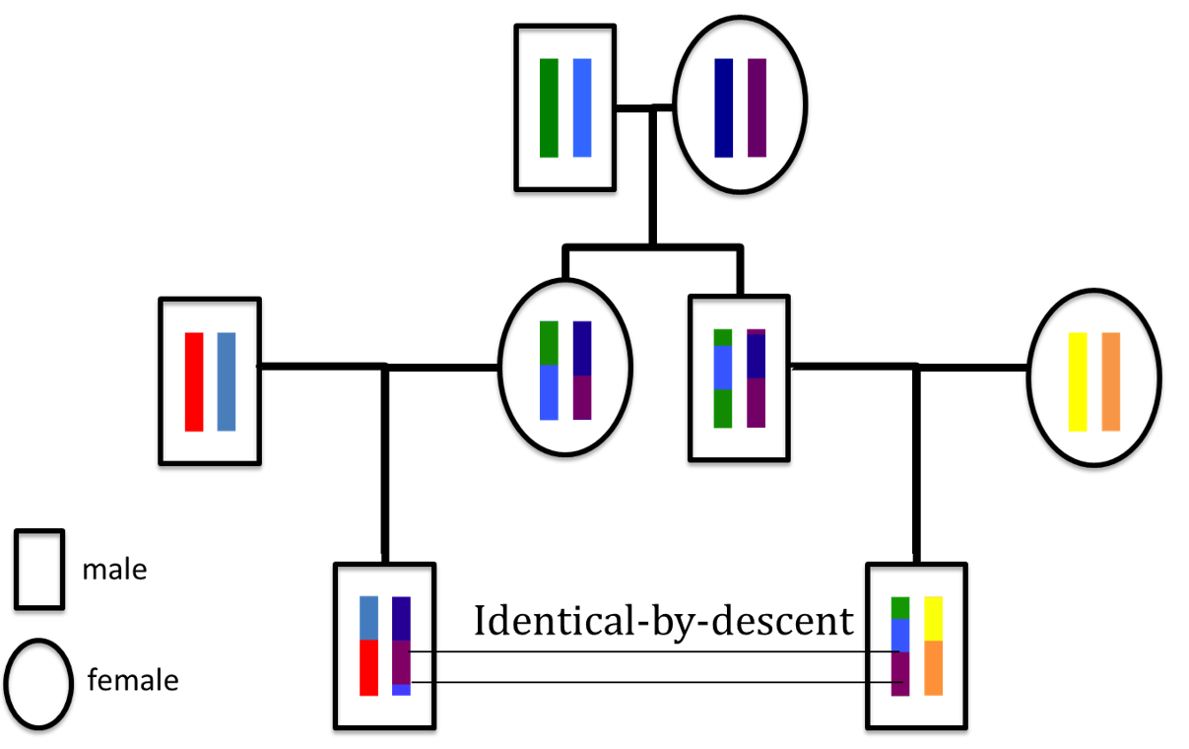
Relatives share haplotypes IBD
Segments of DNA inherited from a common ancestor are said to be identical by descent (IBD)

Slide 85
Relatives share haplotypes IBD
DNA that just happens to be the same is identical by state (IBS)

Slide 86
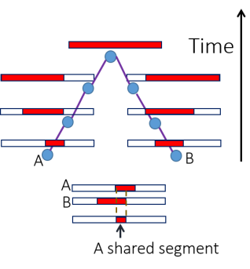
Haplotype sharing decays over time
The longer the IBD segment, the more closely related are the two individuals

Slide 87
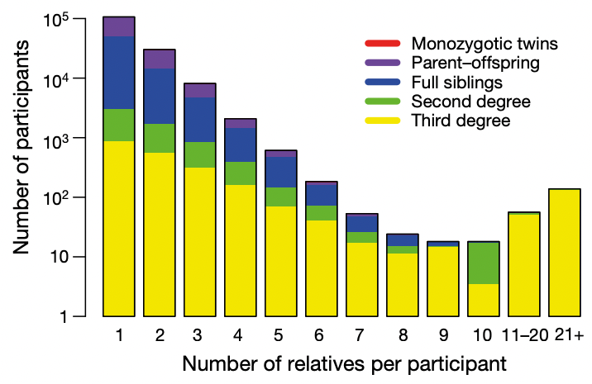
Kinship in genetic association studies
Large genomic datasets, such as the UK Biobank, contain related individuals
https://pubmed.ncbi.nlm.nih.gov/30305743/

Slide 88
Kinship in genetic association studies
Sometimes there is even “cryptic” relatedness
https://pubmed.ncbi.nlm.nih.gov/30305743/

Slide 89
Kinship in genetic association studies
Because of IBD sharing, not all the observations are independent, and genotype-phenotype associations may be confounded
https://pubmed.ncbi.nlm.nih.gov/30305743/

Slide 90
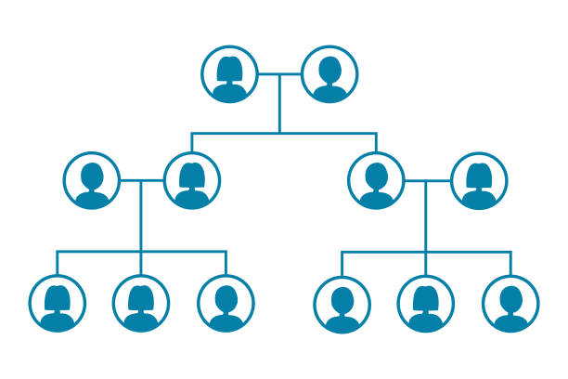
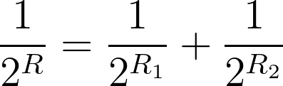
Degree of relatedness
R is the effective number of meioses separating two individuals through their two parents 1 and 2

Slide 91
Degree of relatedness
R → ∞ for unrelated individuals

Slide 92
Degree of relatedness
Parent-child:
R = 1 meiosis

Slide 93
Degree of relatedness
Siblings: R = 1 “effective” meiosis:
1 / 2¹ = 1 / 2² + 1 / 2²

Slide 94
Degree of relatedness
Grandparent-grandchild:
R = 2 meioses

Slide 95
Degree of relatedness
Avuncular:
R = 2 meioses

Slide 96
Degree of relatedness
Cousins:
R = 3 meioses

Slide 97
Degree of relatedness and the fraction of the genome shared IBD
r = 1 / 2^{R} is the fraction of the genome shared IBD, because there is a ½ probability that the gene is passed on in each of R meioses

Slide 98
Degree of relatedness and the fraction of the genome shared IBD
A child shares half of its DNA with its parent
Paternal chr.
Maternal chr.
IBD
IBD
IBD
IBD

Slide 99
Degree of relatedness and the fraction of the genome shared IBD
A child shares (a different) half its of DNA with its full sib
Paternal chr.
IBD
IBD
Maternal chr.
IBD
IBD

Slide 100
Degree of relatedness and the fraction of the genome shared IBD
A child has 0 probability of IBD = 0 with its parent
Paternal chr.
Maternal chr.
IBD
IBD
IBD
IBD

Slide 101
Degree of relatedness and the fraction of the genome shared IBD
A child has 0.25 probability of IBD = 0 with its sib
Paternal chr.
IBD
IBD
Maternal chr.
IBD
IBD

Slide 102
The coefficient of relatedness φ
φ is the probability that any two alleles at a single locus chosen from two individuals are shared IBD
IBD
✕
✕
IBD
✓
✕
R = 1, r = ½, φ = ¼

Slide 103
The coefficient of relatedness φ
φ is equal to half of r = 1 / 2^{R}
IBD
✕
✕
IBD
✓
✕
R = 1, r = ½, φ = ¼

Slide 104
Coefficient of relatedness and IBD = 0
φ decreases as the probability that a pair of individuals should be IBD = 0 increases
Relationship | R | φ | IBD = 0
Monozygotic twins | 0 | 0.5 | 0
Parent-child | 1 | 0.25 | 0
Full sibs | 1 | 0.25 | 0.25
2nd degree | 2 | 0.125 | 0.5
3rd degree | 3 | 0.0625 | 0.75
Unrelated | ∞ | 0 | 1

Slide 105
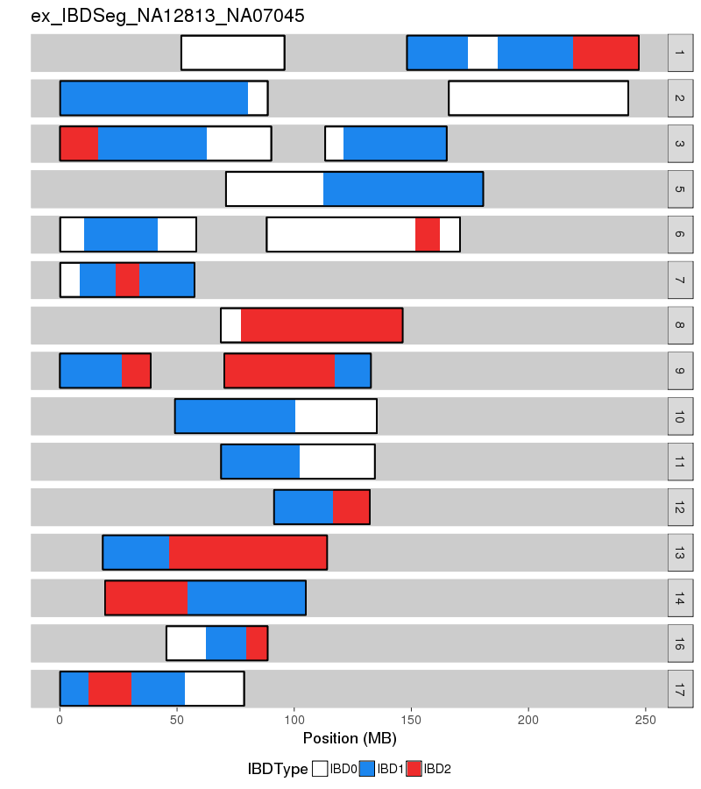
Kinship-based Inference for GWAS (KING)
Estimate φ and IBD sharing from the number of sites at which two individuals are both heterozygotes (Aa,Aa) or opposite homozygotes (AA,aa)
https://www.kingrelatedness.com/manual.shtml

Slide 106
Kinship-based Inference for GWAS (KING)
A robust method that avoids estimating population allele fractions, just focuses on pairs
https://www.kingrelatedness.com/manual.shtml

Slide 107
Kinship-based Inference for GWAS (KING)
Can generate negative estimates of φ, indicating individuals are from distinct populations
https://www.kingrelatedness.com/manual.shtml

Slide 108
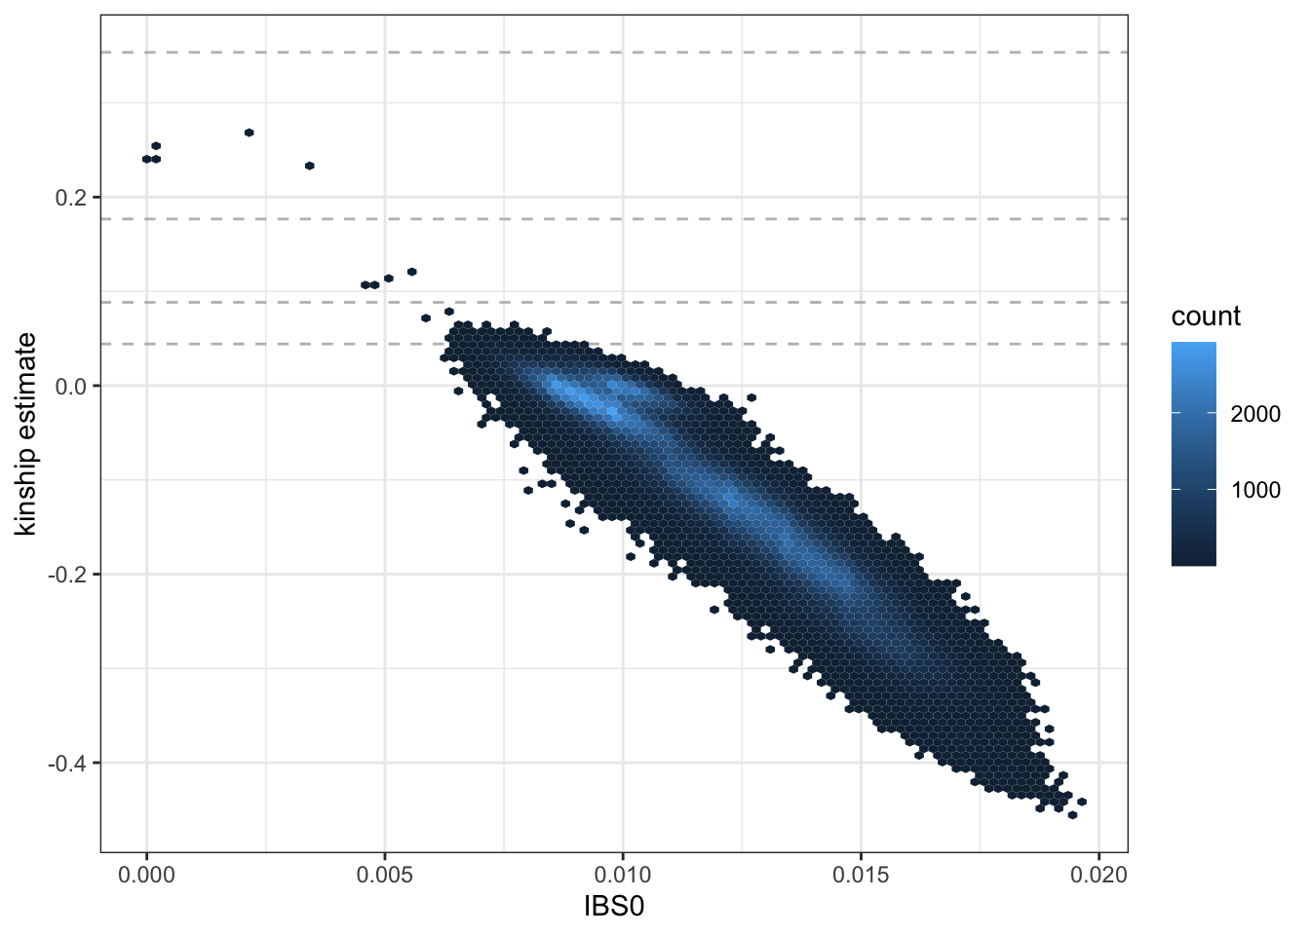
Kinship-based Inference for GWAS (KING)
φ is plotted vs. the fraction of IBS = 0 sites (AA,aa)
https://uw-gac.github.io/SISG_2021/ancestry-and-relatedness-inference.html

Slide 109
Kinship-based Inference for GWAS (KING)
Negative estimates indicate unrelated individuals from different populations
https://uw-gac.github.io/SISG_2021/ancestry-and-relatedness-inference.html

Slide 110
Updating the GRM
The KING kinship coefficients 2φ are approximately equal to the GRM
i
j
i
2φ_{ij}
j
x_{j} · x_{i}

Slide 111
Updating the GRM
But the estimate may be biased by population structure
i
j
i
2φ_{ij}
j
x_{j} · x_{i}

Slide 112
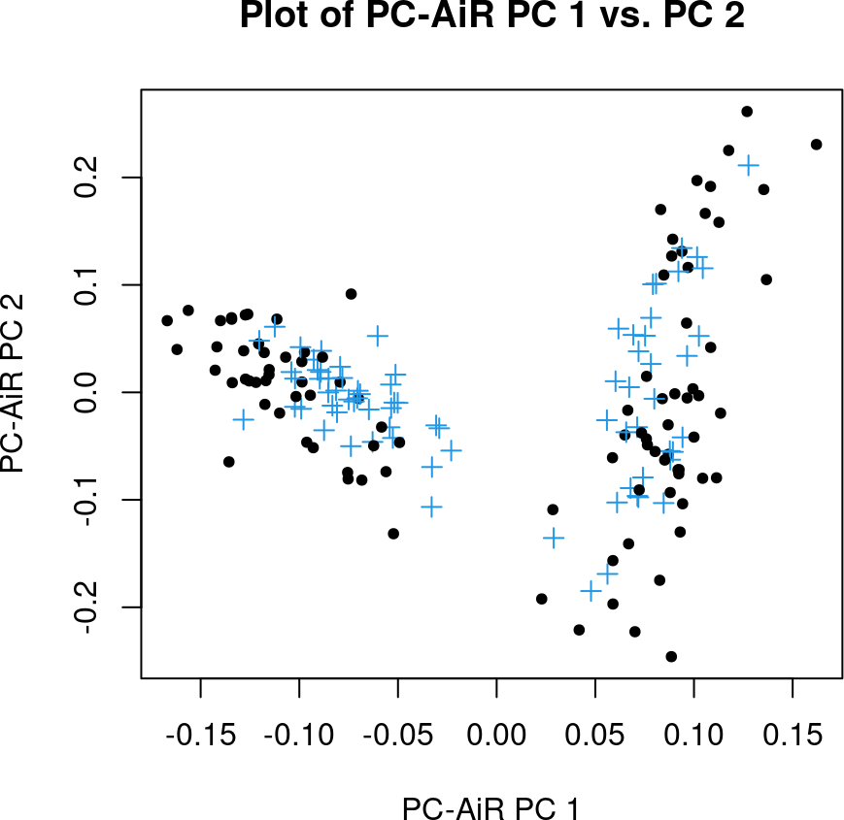
PC-AiR: PCA in Related Samples
Based on the KING estimates, PC-AiR computes PCs for a set of unrelated individuals (black)
https://bioconductor.org/packages/devel/bioc/vignettes/GENESIS/inst/doc/pcair.html

Slide 113

PC-AiR: PCA in Related Samples
Based on the KING estimates, PC-AiR computes PCs U for a set of unrelated individuals (black) with genotype matrix X
https://bioconductor.org/packages/devel/bioc/vignettes/GENESIS/inst/doc/pcair.html

Slide 114
PC-AiR: PCA in Related Samples
PCs for the remaining samples (blue) are imputed into the remaining subset (blue)
https://bioconductor.org/packages/devel/bioc/vignettes/GENESIS/inst/doc/pcair.html

Slide 115

PC-AiR: PCA in Related Samples
PCs U′ for the remaining samples (blue) with genotype matrix X′ are imputed into the remaining subset (blue)
https://bioconductor.org/packages/devel/bioc/vignettes/GENESIS/inst/doc/pcair.html

Slide 116

PC-Relate
PC-Relate uses the updated PCs to distinguish shared genetic ancestry from recent common ancestors
https://pubmed.ncbi.nlm.nih.gov/26748516/

Slide 117
PC-Relate
Each individual’s “best-fit” genotype is predicted from its PCs

Slide 118
PC-Relate
Each individual’s “best-fit” genotype is predicted from its PCs
Population allele frequency
Amount of ancestry j
SNP k genotype in ancestry j

Slide 119

PC-Relate
The slope of the best fit line of genotype vs. (weighted) PC1 is equal to the expected SNP genotype in ancestry 1
Slope V₁₁ = 1.49

Slide 120

PC-Relate
i
j
An updated GRM that reflects only recent common ancestry can be constructed using the “best-fit” genotypes 2pik for each individual I at SNP k
i
2φ̂_{ij}
j
x′_{j} · x′_{i}

Slide 121
PC-Relate
i
j
The updated GRM will be used for fitting a generalized linear model during association testing
i
2φ̂_{ij}
j
x′_{j} · x′_{i}

Slide 122
Association testing
Logistic regression and linear mixed models

Slide 123

Case-control studies
Is a genetic variant associated with disease?

Slide 124
Case-control studies
Is a genetic variant enriched in people with disease compared to people without?

Slide 125
Case-control studies
To find out, collect many people with disease (Cases) and many healthy individuals (Controls) from the same population

Slide 126
The odds ratio
The OR is the ratio of the odds that Cases have the risk allele (a / c) to the odds that Controls have the risk allele (b / d)
Cases
Controls
C
a
b
T
c
d
OR = (a / c) / (b / d) = (ad) / (bc)

Slide 127
The odds ratio
The OR is the ratio of the odds that Cases have the risk allele (620 / 380) to the odds that Controls have the risk allele (490 / 510)
Cases
Controls
C
620
490
T
380
510
OR = (620 × 510) / (490 × 380) = 1.70

Slide 128
The odds ratio
The OR is a crude measure of association that is not adjusted for other covariates (age, sex, ethnicity, etc.) that may also be associated with disease
Cases
Controls
C
620
490
T
380
510
OR = (620 × 510) / (490 × 380) = 1.70

Slide 129

Linear vs. logistic regression
In linear regression, we can find the association of a continuous variate Y with a predictor X₁ and other covariates X₂, X₃, etc.

Slide 130

Linear vs. logistic regression
Best estimate of the slope of Y vs. X

Slide 131

Linear vs. logistic regression
Standard error of the estimate

Slide 132
Linear vs. logistic regression
Using the t-test, we can find out if β̂ / s is statistically significantly different from 0

Slide 133
Linear vs. logistic regression
In logistic regression, we can find the association of a binary variate Y with a predictor X₁ and other covariates X₂, X₃, etc.

Slide 134
Linear vs. logistic regression
The sigmoid curve is an individual’s probability of developing disease

Slide 135

Linear vs. logistic regression
The logistic model describes an individual’s unobserved disease risk

Slide 136

Linear vs. logistic regression
The logit function turns this problem into one of linear regression

Slide 137

Linear vs. logistic regression
Logistic regression can be thought of as linear regression is we transform the OR into the log(OR), and regress vs. SNP genotype

Slide 138

Linear vs. logistic regression
Other covariates can be accounted for as additional independent variables

Slide 139
Linear vs. logistic regression
The model is actually fit using the principle of maximum-likelihood

Slide 140

Linear vs. logistic regression
Y_{i} is a binary indicator of disease for individual i, and p_{i} is the unobserved (conditional) probability of disease

Slide 141

Linear vs. logistic regression
The log-likelihood is a convex function of the parameters β which we can maximize

Slide 142

Linear vs. logistic regression

Slide 143
Linear vs. logistic regression
Maximum, ∂ℓ/∂β = 0
Curvature, −1/(∂²ℓ/∂β²)

Slide 144
Simulating a binary phenotype
a
b
If odds = a / b, then prob = a / (a + b) = odds / (1 + odds)

Slide 145

Simulating a binary phenotype
a
b
β₀ is the baseline odds
β₁ is the log-OR
X₁ is the SNP genotype
If odds = a / b, then prob = a / (a + b) = odds / (1 + odds)

Slide 146

Simulating a binary phenotype
a
b
prob is the probability of developing disease (being a Case in the study)
If odds = a / b, then prob = a / (a + b) = odds / (1 + odds)

Slide 147

Simulating a binary phenotype
a
b
β₀ becomes the mean log-odds, so that the mean odds of disease is 1 (50% Cases, 50% Controls)
If odds = a / b, then prob = a / (a + b) = odds / (1 + odds)

Slide 148
Estimating the SNP effect
We want to be able to detect the association of one SNP with disease by fitting the model Y = β₀ + β₁X₁ + ··· and finding a slope β₁ significantly different from 0

Slide 149

Estimating the SNP effect
A Manhattan plot gives the p-value of the log-OR estimate for each SNP

Slide 150
Estimating the SNP effect
Because there are more SNPs than subjects, we cannot fit all SNPs at once

Slide 151
Estimating the SNP effect
But we can fit one SNP plus the “average” effect of all the remaining SNPs

Slide 152
Linear mixed models
i
j
The solution for the best estimate of the SNP effect β₁ in the presence of all the remaining SNPs involves the GRM ZZ^{T} (from PC-Relate)
i
2φ_{ij}
j
z_{j} · z_{i}

Slide 153
Linear mixed models
Other covariates X commonly included in the model are age, sex, and the first few genotype principal components (from PC-AiR)

Slide 154
Linear mixed models
If the model including the SNP represents a significant improvement over the null model (the model without the SNP), we can reject the null hypothesis that the OR = 1

Slide 155
Linear mixed models
But because of multiple-testing, our p-value threshold is 0.05 / 10⁶ (i.e., you perform the same test 10⁶ times)
5.0 × 10⁻⁸

Slide 156
Linear mixed models
SNPs with p < 5.0 × 10⁻⁸ are said to achieve genome-wide significance
5.0 × 10⁻⁸

Slide 157

QQ plots
To assess if the distribution of SNP effects is significantly different from that expected by chance, we make a quantile or QQ plot

Slide 158
QQ plots
The expected p-values for the quantiles of m SNPs are 1/m, 2/m,..., 1

Slide 159
QQ plots
Take the negative log-10 and put in order from smallest to biggest

Slide 160
QQ plots
SNPs falling above the line of identity indicate an excess of quantiles (β’s) with small p-values

